Slide 1
Information systems fundamentals
course’s project
DynamoDB
Andres Ochoa Hernandez
September 2022

Slide 2
What’s DynamoDB ?
DynamoDB is a fully managed NoSQL database service that provides fast and predictable perfomance and seamless scalability
It belongs to the family of systems based on Dynamo (Amazon’s published paper in 2007) like Cassandra, Riak, and Linkedin’s Voldemort
It has a key-value data model

Slide 3
DynamoDB’s main constructs
Tables : A table is a collection of items
Items : An item is an instance of information. It’s similar to a row in a relational database
Attributes : Each item contains some properties that hold values (max nesting level : 32)
Primary Key : Identifies an item uniquely amongst the table.
DynamoDB supports two configurations for the primary key:
Partition key: Every item is uniquely identified by one attribute. The system use it to determine the physical partition in which the item will be stored.
Composed primary key : Every item is uniquely identified by two attributes: the partition key and the sort key. The partition key is used as the previous case. The sort key determines the order of the items that have the same partition key.
Secondary Index : Allows to access the items using attributes different from the primary key. DynamoDB supports two types of secondary indexes:
Global secondary index : Has a different partition and sort key (max 20 GSI per table)
Local secondary index : Has the same partition key but a different sort key
(max 5 LSI per table)

Slide 4
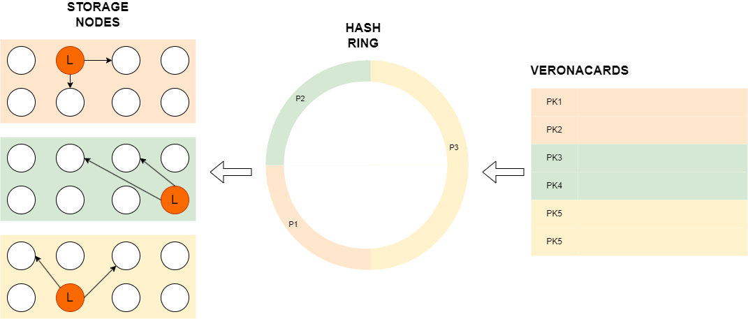
DynamoDB’s Architecture

Slide 5
DynamoDB’s Architecture - Consistent hashing
DynamoDB tables are partitioned across multiple nodes. How to know where to put an item?
DynamoDB uses a technique called «consistent hashing»
The hash function takes the primary key of an item as input and it generates a hash code in a fixed range
The range is divided equally amongst the nodes. Each sub-range is assigned to a node. What if new nodes are added?
To avoid re-mapping the entire hash function, only the minimum amount of ranges are changed. For example: there are 4 ranges, each one assigned to a node. If a 5°node is added only the first range has to be modified. In this case it could be split in half: the first one will be assigned to node 1, the other to node 5
Another used technique are virtual nodes: The hash range is divided in a set of predetermined nodes. As nodes are added to the cluster the virtual nodes are re-assigned to balance the load

Slide 6
DynamoDB’s Architecture - Node Coordination
In DynamoDB there are no specialized nodes, each node is capable of performing any of the activities that are necessary for cluster operation
For each partition there are three nodes, each of which contains a copy of that partition’s data.
One of the three nodes is elected as «Leader» via the Paxos algorithm.
Paxos is an algorithm that aims to get distributed machines to all agree on a result, in this case the «Leader»
Every write request must be addressed by the leader. To be eligible as such one node must be up to date with the mutations of the object
Every 1.5 seconds the «Leader» sends a heartbeat to the other nodes, letting them know its status.
If a node starts missing some heartbeats from the leader it can start a new election round.

Slide 7
DynamoDB’s Architecture - Consistency
DynamoDB allows the application to define the level of desired consistency. This concept is called tunable consistency and is defined by three parameters :
N: Number of copies of an item
W: Number of writes before declaring a write as «succesful»
R: Number of reads to do find the correct value of an item’s attribute
Defaults setting in DynamoDB are N = 3, W=2, R=1.
This setting results in an eventual consistent system, which means that is allowed - temporalily - to do reads that are inconsistent to the real state of the database. In different words, after a short period of time, the system will be consistent
Let’s calculate the odds of having an inconsistent read:
Since the leader is consistent by definition, and a write is successfull when two nodes complete the write and the request handler chooses randomly one of the three nodes for a read request, it means that we have a 33.33% chance of an inconsistent read

Slide 8
DynamoDB API – python – boto3
CLIENT : First of all, it’s necessary to create an instance of the client, to allow us to communicate with either the AWS or the local instance of dynamodb(dynamodblocal)
dynamoDbClient = boto3.resource(
'dynamodb',
endpoint_url = 'http://localhost:8000',
region_name = 'eu-west-1',
aws_access_key_id = 'user',
aws_secret_access_key= 'password’
)
When interacting with the AWS is not necessary to specify «endpoint_url» and it’s necessary to specify the correct access key id, secret key, and region name.
When interacting with DynamoDBLocal, it’s necessary to specify the correct endpoint. The other parameters can be dummy values

Slide 9
DynamoDB API – python – boto3
CREATE TABLE :
dynamoDbClient.create_table (
TableName = 'Dispositivi',
KeySchema = [{'AttributeName': 'Codice', 'KeyType' : 'HASH'}, {'AttributeName': 'Name', 'KeyType' : 'RANGE'}],
AttributeDefinitions = [ {'AttributeName': 'Codice', 'AttributeType': 'S'}, {'AttributeName': 'Name', 'AttributeType': 'S'}],
GlobalSecondaryIndexes = [{'IndexName' : 'IndiceName', 'KeySchema' : [ {'AttributeName': 'Name', 'KeyType': 'HASH'}],
'Projection': {'ProjectionType': 'ALL'}, 'ProvisionedThroughput': {'ReadCapacityUnits': 10, 'WriteCapacityUnits': 10}}],
ProvisionedThroughput={'ReadCapacityUnits':10, 'WriteCapacityUnits':10}
)
When creating a table it’s mandatory to specify the parameters in red:
Table name
keySchema : where you must specify the partition key’s name and type and eventually the sort key’s name and type
AttributeDefinitions : where you must specify the fundamental type of the partition key and - eventually - the sort key
GlobalSecondaryIndexes : where you specify all of the required parameters of the GSIs
ProvisionedThroughput: where you specify the ReadCapacityUnits(RCU) and the WriteCapacityUnits(WCU).
ProvisionedThroughput is a billing mode in wich the application specifies the average RCUs and WCUs, and AWS charge you for that
specified amount. 1 RCU means that you can perform a strongly consistent read in one second - or two eventually consistent reads – of and
object up to 4KB. With 1 WCU you can perform one write per second of objects up to 1KB.

Slide 10
DynamoDB API – python – boto3
GET A TABLE :
dispositiviTable = dynamoDbClient.Table(‘Dispositivi’)
PUT ITEM :
dispositiviTable.put_item(Item={‘Codice’:40,’Name’:’Casa Giulietta’})
BATCH WRITE ITEM :
It’s possibile to perform a more efficient write using BatchWriter. It can write up to 25 items reducing the API calls (each item’s size can be up to 400 KB and the total size of the items can be up to 16 MB )
with dispositiviTable.batch_writer() as batch:
for dispositivo in listOfDispositivi:
batch.put_item(Item = dispositivo)
GET ITEM :
dynamoDbClient.Table('Dispositivi').get_item(Key={'Codice':'25','Name':'Arena'})

Slide 11
DynamoDB API – python – boto3
QUERY:
dynamoDbClient.Table('VeronaCards').query(
TableName='VeronaCards’,
KeyConditionExpression=Key('CodiceSeriale').eq('04FA80523F3880’)&
Key('ChiaveOrdinamento').begins_with('40’)
)
In the field KeyConditionExpression it’s possibile to specify the boolean condition of the partition key and sort key. For the partition key the only supported clause is the equality, for the sort key all other clauses of comparison are allowed ( <,>, between etc.. and begins_with). It’s not possible to use non-key attributes in this field. Optionally you can add a FilterExpression on non-key attributes
SCAN :
dynamoDbClient.Table('VeronaCards').scan(
FilterExpression=Attr('ChiaveOrdinamento').contains('30-12-16’)
)
This instruction scans and returns a number of items with a total size equal to 1 MB (To get all items in a table it’s necessary to do more scans). It’s possible to specify a FilterExpression (to all attributes, including the primary key ones) that will be applied before returning the items

